Slide 1

Workplace wellbeing has never looked so good.
Smart Health for group protection

Slide 2
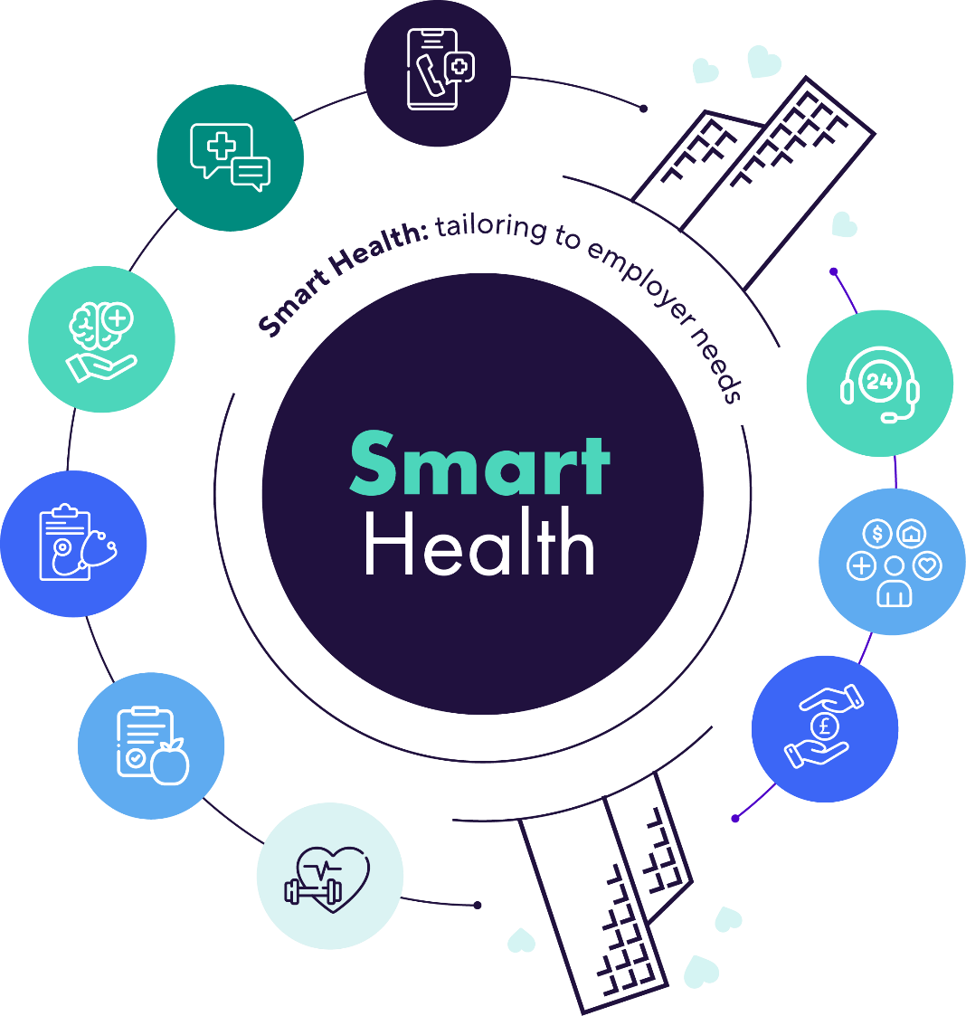




Smart Health’s here to make work a happier, healthier place to be – mentally, physically and financially.
Online GP
Second medical opinion
Get access to award-winning health and wellbeing support from day one.
Mental health support
Health check
Nutrition advice
Fitness plans
24/7 mental health helpline
myStrength app
Legal & financial support
Notes:
Speaker notes
An enhanced version of Smart Health
Online GP
With Smart Health you’ve got unlimited, round-the-clock access to a whole host of doctors
Chat by phone or video call – whatever works for you
UK-based GPs on hand for things like medical advice, prescriptions or specialist referrals
Second medical opinion
World-leading experts are here for a second opinion
You’ll be matched with your very own GP case manager to help you through the process
Get an expert opinion on a diagnosis or treatment plan from one of over 50,000 global specialists
Mental health
Sessions with a qualified mental health specialist
Support with things like anxiety, stress and bereavement
Health check
Get personalised recommendations based on your height, weight and heart health
Get advice on any tests or screening that might help
No limit to the number of health checks you can have
Nutrition advice
Expert nutritionists are on hand to help you meet your nutrition goals
Tailored weekly menus and recipe ideas to keep you focused
Fitness plans
A team of coaches and fitness experts on hand to keep you on track
Receive a 4 or 8 week programme personalised to you
24/7 mental health helpline
Immediate emotional support to mental health patients 24/7/365
Helpline is staffed by mental health practitioners qualified and experienced in offering immediate mental health support
Helpline is monitored and supervised by senior clinicians
Specialist help - whether it’s how to cope with stress, anxiety, trauma or depression or dealing with a recent bereavement
Not an alternative to emergency services, however it can offer emotional reassurance and de-escalation in times of distress for the patient
If further support is needed helpline staff will signpost or refer patients internally or externally to alternative resources
myStrength app
A digital mental health support to encourage emotional wellness
Digital content that provides skill building, resiliency and hope and inspiration to users to address their overall mental wellbeing
Programmes including improving mood, managing anxious thoughts, reducing stress mindfulness, meditation and balancing intense emotions
Can be used as a standalone wellbeing app or to support treatment
Tailored on-demand activities or your very own guide helping you on the way to wellness
A chat-based service is available for additional guidance
Legal and financial support
Information and support on topics including probate divorce, landlord rights, tenant rights, immigration law, personal injury, consumer disputes, property disputes (not conveyancing)
Information and support on topics including assistance with completing standard financial statements, advice on out of work and top-up benefits; advice on reducing outgoings, budgeting, financial education; advice on reducing energy bill-social tariffs, energy switch, reduce usage and Warm Home Discount; information on Pension credit and available state support.
Impartial information and guidance on personal legal and financial questions from professionals
Available from 9.00am - 5.30pm, Monday to Friday

Slide 3

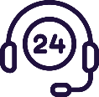


Looking after your mental health is key to making sure you lead a happier, healthier life
myStrength app
Mental health support encouraging emotional wellbeing
Digital content providing skill building and resiliency for people to support their mental wellbeing
Programmes including mood improvement, managing anxious thoughts, reducing stress, mindfulness, meditation and balancing intense emotions
Can be used as a standalone wellbeing app
or to support treatment
24/7 mental health helpline
Immediate emotional support 24/7/365
Helpline staffed by mental health practitioners qualified and experienced in offering immediate mental health support
Specialist help - whether it’s how to cope with stress, anxiety, trauma, depression or dealing with a bereavement
Smart Health will refer people for further support if needed
Mental health support
Team of qualified Mental Health experts on hand for confidential support
Whether you need help coping with stress, anxiety, depression or you’re just not feeling yourself
Benefit from therapy sessions with a psychologist Find the right coping strategies for you and your needs

Slide 4



Smart Health supporting mental health
Becky’s had a tough day at work where she feels like everything’s got on top of her.
She calls the 24/7 mental health support line to just have a chat. The staff listen and help her put things into perspective.
She goes home and speaks to her partner, who’s had an equally stressful day. They’re not helping each other.
They recommend she talk to her line manager for some advice on her workload / ways of working.
She remembers she’s got access to Smart Health through her employer, so requests a consultation from a mental health specialist.
They also advise she download the myStrength app so she can access the digital content to help herself reduce stress in her life.
The person she speaks to recommends some therapy sessions for Becky to talk through her worries.
As Smart Health is also available to employees’ families, they recommend Becky’s partner downloads Smart Health and arranges to speak to a mental health specialist.
Notes:
Speaker notes
An example of how Smart Health’s set of mental health services can be used in conjunction – all aiming to provide the right support to the employee

Slide 5



Legal and financial support
Get guidance from legal and financial representatives
Service covers topics like probate, divorce, benefits, budgeting
Available from 9am - 5.30pm, Monday to Friday
AIG Life | Smart Health for Group
Notes:
Information and support on topics including probate, divorce, landlord rights, tenant rights, immigration law, personal injury, consumer disputes, property disputes (not conveyancing)
Information and support on topics including help with completing standard financial statements, advice on out of work and top-up benefits; advice on reducing outgoings, budgeting, financial education; advice on reducing energy bill-social tariffs, energy switch, reduce usage and Warm Home Discount; information on Pension credit and available state support.

Slide 6
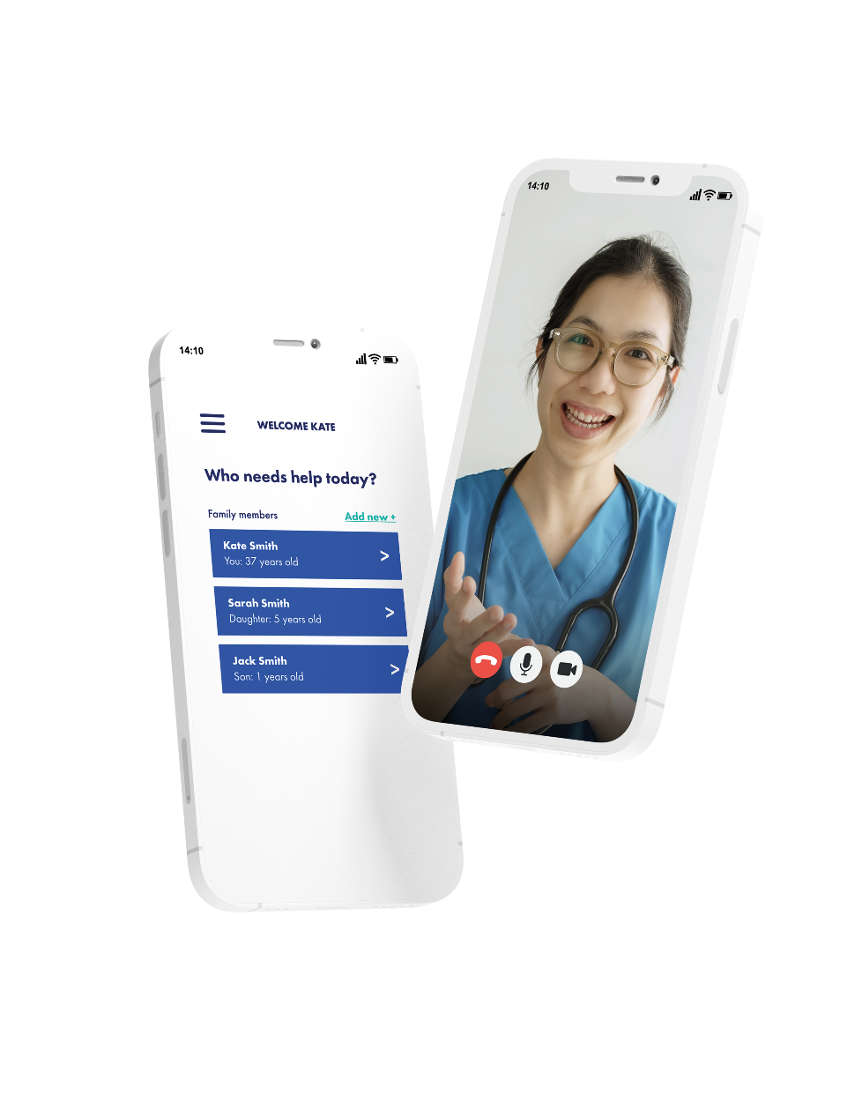


Getting started
All Smart Health services can be accessed through the app or online. It’s the same log in details for both. Visit aiglife-smarthealth.com or download the Smart Health app.
It’s as easy as 1, 2, 3
01
Time to create your very own Smart Health account. It’s a good idea to get registered straightaway, so you’re ready to go when you need it. Everyone over 18 sets up their account on their own device − any children will need to be added to a parent or guardian’s account.
02
Note down the company access code – you’ll need this when you sign up.
Access code:
[xxxxxxxxxx]
03
Have your passport or driving licence to hand when signing up for the first time. You’ll need to complete a quick ID check to make sure it’s really you using the service.
Your access code: [xxxxxxxxxx]
Scan the QR code to download the app and start using Smart Health today.
AIG Life | Smart Health for Group
Notes:
Reminder that access is via self-registration with the scheme number as the access code
Whether it’s the app or the website, a better user experience awaits. Smart Health’s been upgraded and it’s never been easier to find your way around.

Slide 7


All employee health and wellbeing services provided by Smart Health
Register using the company access code
Services under
one roof
Access via the app or portal
AIG Life | Smart Health for Group
Notes:
Speaker notes
A reminder to register for Smart Health – so it’s ready to go when you need to use it.
Smart Health brings together:
Physical health
Mental wellbeing
Financial support
Legal advice
All under one log in.
It’s the same great service people know and love.
24/7 support
Unlimited usage
Family access- your partner and children aged up to 21
No additional cost
Use it from anywhere
The app is available on both Apple and Android systems – as well as the website: www.aiglife-smarthealth.com

